Slide 1
Tidify
-- tidy up and simplify

Slide 2
The problem
How to dispose of clutter at home
The solution
Identify possibilities of safe disposal and donation
Notes:
motivation

Slide 3
Recycle
Reuse
-- What materials is my clutter made of?
-- Is any material dangerous?
-- Where can I safely and ecologically dispose of my clutter?
-- Where can my clutter get a new life?
-- Is any of my clutter valuable?
-- Lower carbon footprint by community resource redistribution
Notes:
Added value?

Slide 4
Target users
-- Households
-- Small second-hand businesses
-- Charities and social nonprofits
Notes:
Target users

Slide 5
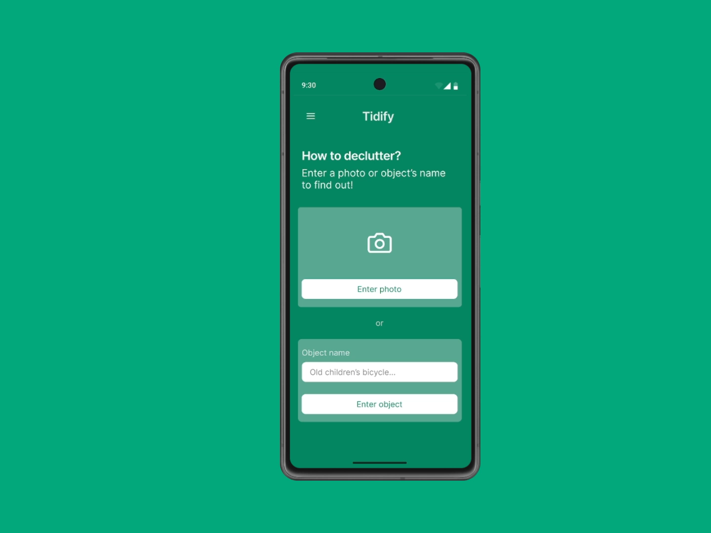

Slide 6


Architecture

Slide 7
The future
-- Analysing data about clutter accumulation
-- Analysing data about the second-hand market
-- Direct contact between donors and recipient (no 3rd party)
-- Targeted donation
Notes:
Added value?

Slide 8

Notes:
Added value?

